Slide 1
Uniparental disomy and disorders of imprinting

Slide 2
Nine major syndromes caused by uniparental disomy:
Beckwith-Wiedemann syndrome Chr 11 pat upd
Prader-Willi syndrome Chr 15 mat upd
Angelman syndrome Chr 15 pat upd
Silver-Russell syndrome Chr 7 mat upd
Kagami syndrome Chr 14 pat upd
Temple syndrome Chr 14 mat upd
Transient neonatal diabetes Chr 6 pat upd
Maternal UPD 20 Chr 20 mat upd
Pseudohypoparathyroidism type 1B Chr 20 pat upd
UPD can be the cause of homozygosity for an autosomal recessive gene
Most UPDs appear to be without any phenotypic consequence

Slide 3
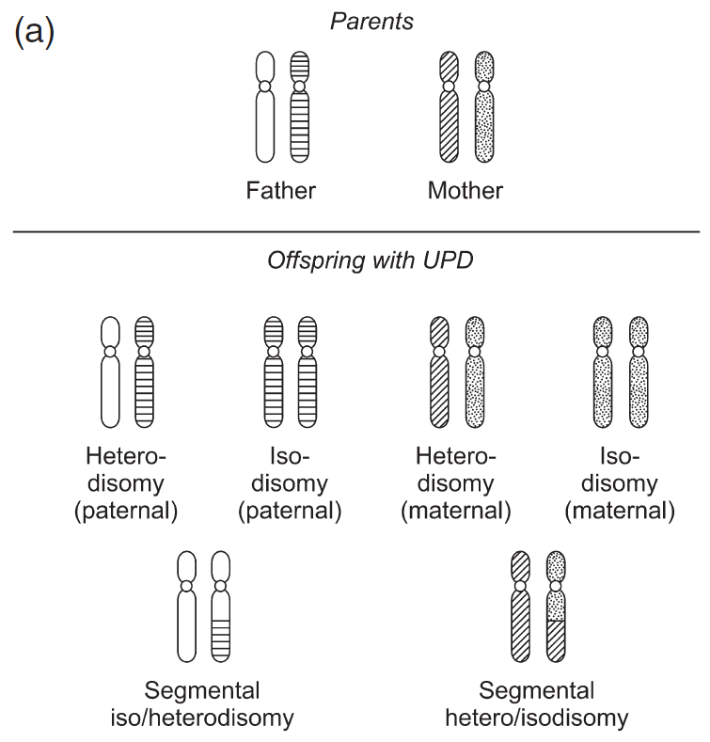
In UPD both chromosomes can be either:
identical (uniparental isodisomy, UPID) reflecting meiosis II nondisjunction or mitotic error (including monosomy rescue)
different (uniparental heterodisomy, UPHD) reflecting nondisjunction at meiosis I
Partial heterodisomy and partial isodisomy can coexist for the same chromosome pair

Slide 4
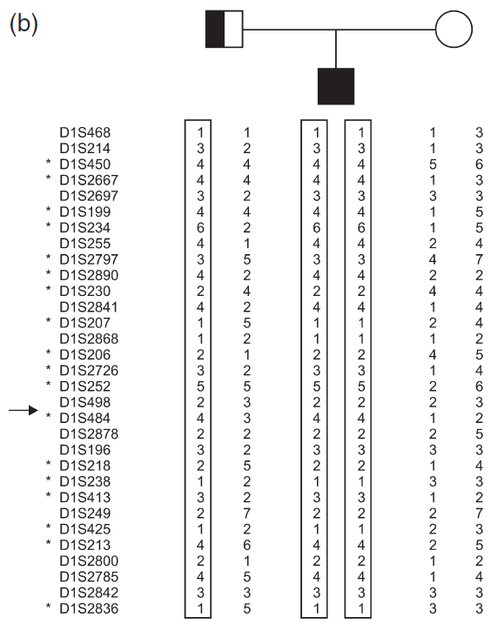
The molecular picture of a child with paternal uniparental isodisomy 1
Homozygosity for an abnormal TRKA allele was the cause of his having the recessive condition congenital insensitivity to pain, which had led to his ascertainment.

Slide 5
A core consideration in epigenetics is that a phenotype may differ according to whether a DNA sequence is active, or inactive, but the DNA sequence itself remains unchanged
Imprinting refers to nonactivity: an imprinted chromosome segment is silenced, while the nonimprinted chromosome segment is the active one depending on the “parent of origin”
Imprintable segments (or loci) function monoallelically
If both segments originate from one parent, there will be either:
double the amount (biallelic) of expression, or
no (nulliallelic) expression
» the root cause of the phenotypic effect in the UPD syndromes

Slide 6
If a chromosome is not subject to imprinting, UPD does not of itself cause abnormality, unless UPID leads to homozygosity for a recessive mutation (“isozygosity”)

Slide 7
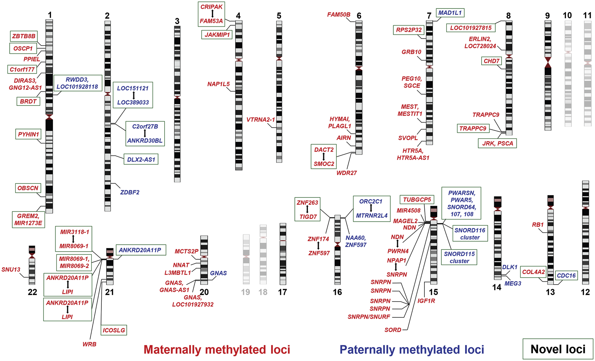
Figure 18–2 A display of autosomal segments subject to an imprinting effect, from a cohort of 57 cases of UPD

Slide 8
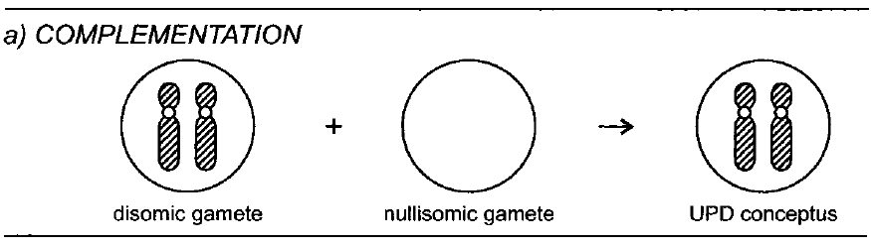
Four mechanisms whereby complete uniparental disomy (UPD) may be generated
a) Gametic complementation, with one parent producing a disomic gamete, and the other a nullisomic gamete
More of a theoretical route than a practical one

Slide 9
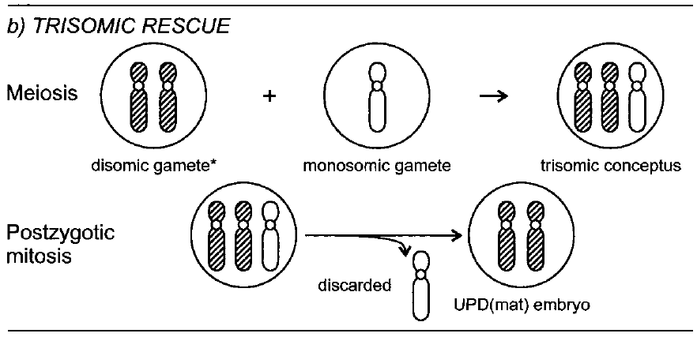
b) Meiotic nondisjunction in one parent to produce a disomic gamete, with a trisomic conceptus following fertilization, and subsequent mitotic loss of the homolog from the other parent
Most UPDs follows this mechanism

Slide 10
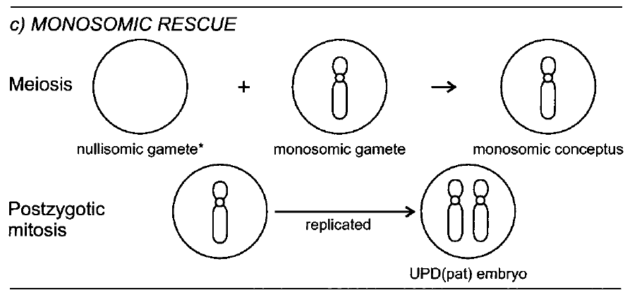
Meiotic nondisjunction in one parent to produce a nullisomic gamete, with monosomic conceptus following fertilization, and subsequent mitotic reduplication of the homolog from the other parent. This is uniparental isodisomy, from the parent who had contributed the normal gamete

Slide 11
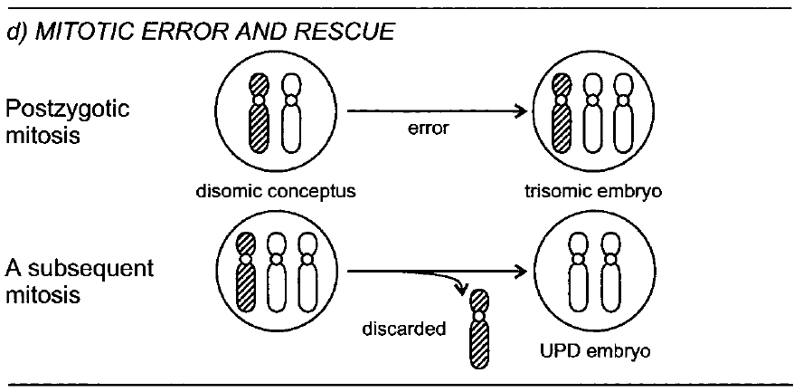
Two sequential mitotic errors. Resulting UPD is isodisomic

Slide 12
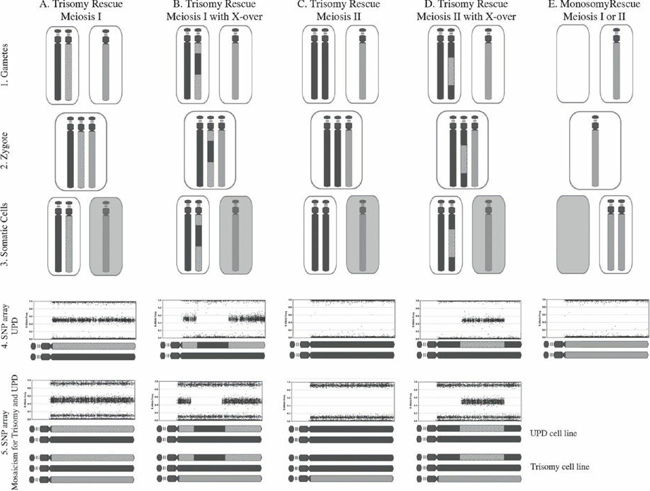
FIGURE 18–4 The several routes by which UPD may arise, and the observations on SNP array that may inform interpretation.

Slide 13
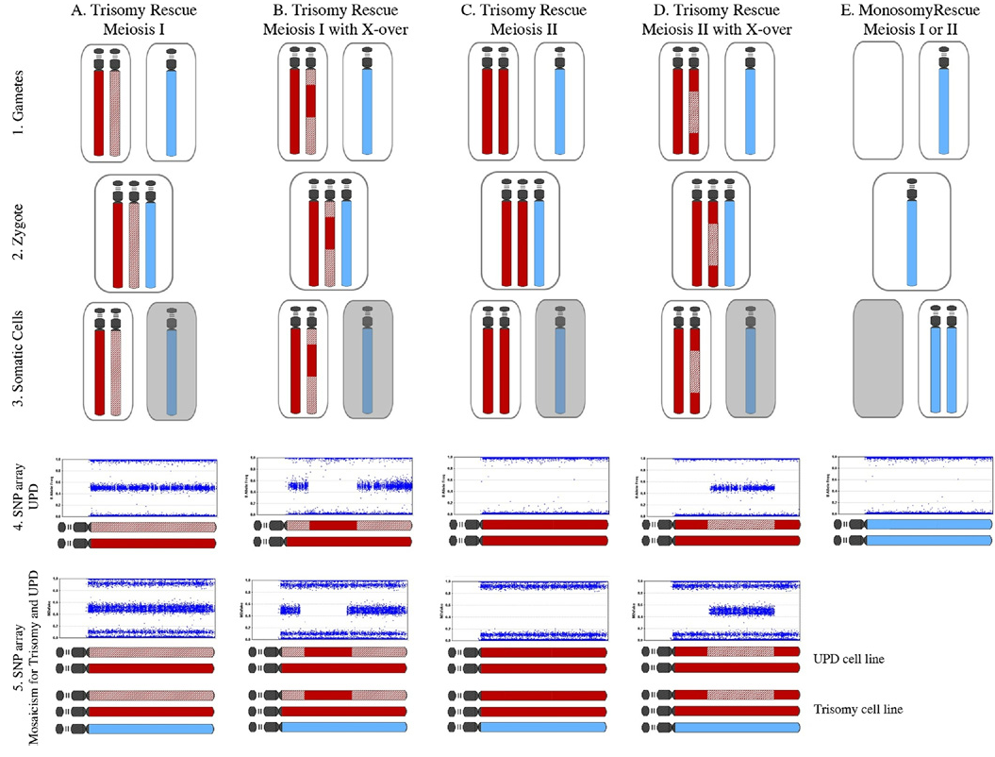

Slide 14
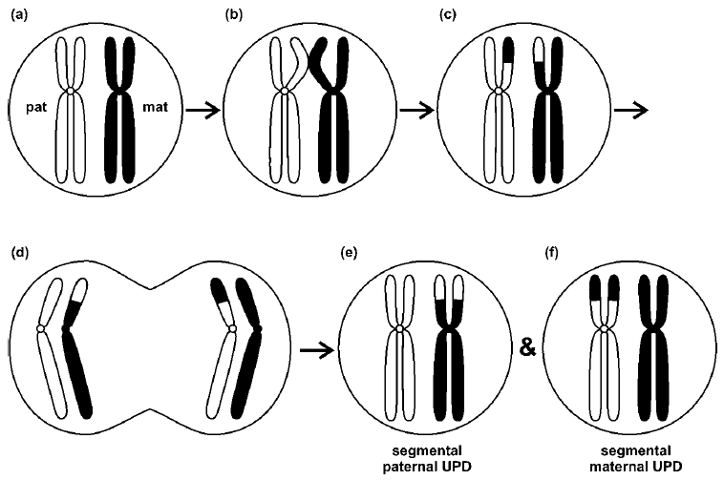
Segmental Uniparental Disomy
Segmental UPD may arise as the consequence of a postzygotic somatic recombination, between the maternal and paternal homolog, and in that case it will necessarily be an isodisomy

Slide 15
Aberrant imprinting in a biparental setting
Differential methylation at a particular imprinted locus can be due to:
loss of imprinting, leading to expression from both alleles
gain of imprinting, leading to loss of expression
Some BWS with normal biparental inheritance show biallelic expression of two imprinted genes. Overexpression of genes contribute to the overgrowth that is characteristic of the syndrome
One cause of aberrant imprinting may relate to pregnancy following assisted reproductive technology; aspects of the process of artificial ovulation stimulation, or of the embryo’s environment in vitro, may disturb DNA methylation

Slide 16
Uniparental disomy phenotypes
UPD for any chromosome is estimated to be 1 in 2,800 births and has been observed for every chromosome
For most chromosomes, there is no apparent phenotypic consequence
UPDs of chromosomes 6,7,11,14,15, 20 result in clinical phenotypic abnormalities
Undetected residual trisomy might contribute to a phenotype, when the UPD mechanism has been trisomy correction
Imprinted loci are predicted to be present on all chromosomes
It remains possible that more subtle and/or later-onset phenotypes, such as effects on behavior and intelligence, a risk for cancer, and other complex disease predisposition, may have escaped notice

Slide 17
Chromosome 6
Transient neonatal diabetes mellitus (TNDM), a hyperglycemia requiring treatment with insulin, with gradual resolution to normal glucose within few months.
The three reported mechanisms, occurring in approximately equal proportions, are:
UPD6pat
Maternal hypomethylation of the differentially methylated region (DMR) at 6q24
Paternally inherited duplication of 6q24, this latter accounting for all familial cases
One report showed UPD6pat case without apparent effect
No consistent phenotype has been associated with upd(6)mat, although intrauterine growth retardation has been noted in about half of reported cases

Slide 18
Chromosome 7
Silver-Russell syndrome (SRS), intra-uterine and postnatal growth retardation, often associated with limb asymmetry
~10% of SRS are due to maternal UPD7 (other causes include chromosome 11 abnormalities)
SRS due to UPD7mat presents with more speech and language difficulty, but less incidence of congenital abnormality
The specific loci responsible for UPD7 imprinting have not been identified
No phenotype appears to be associated with paternal UPD7

Slide 19
Chromosome 11
There are growth regulation loci in 11p15 that are expressed monoallelically, according to parent of origin
Paternally expressed genes: IGF2 & KCNQ1OT1
Maternally expressed genes: H19 & CDKN1C
DMR1 DMR2
(differentially methylated region)
Beckwith-Wiedemann syndrome (BWS): Overgrowth
Silver-Russell syndrome (SRS): Growth retardation

Slide 20
20% of BWS due to mosaic segmental UPD(11p)pat
That BWS patients with paternal UPD always show mosaicism indicates a mitotic origin and suggests that nonmosaic paternal UPD 11 is an embryonic lethal
IGF2 & KCNQ1OT1 expressed biallelically
H19 & CDKN1C silenced (nulliallelic)
Epigenetic mechanisms exist due to other than UPD

Slide 21
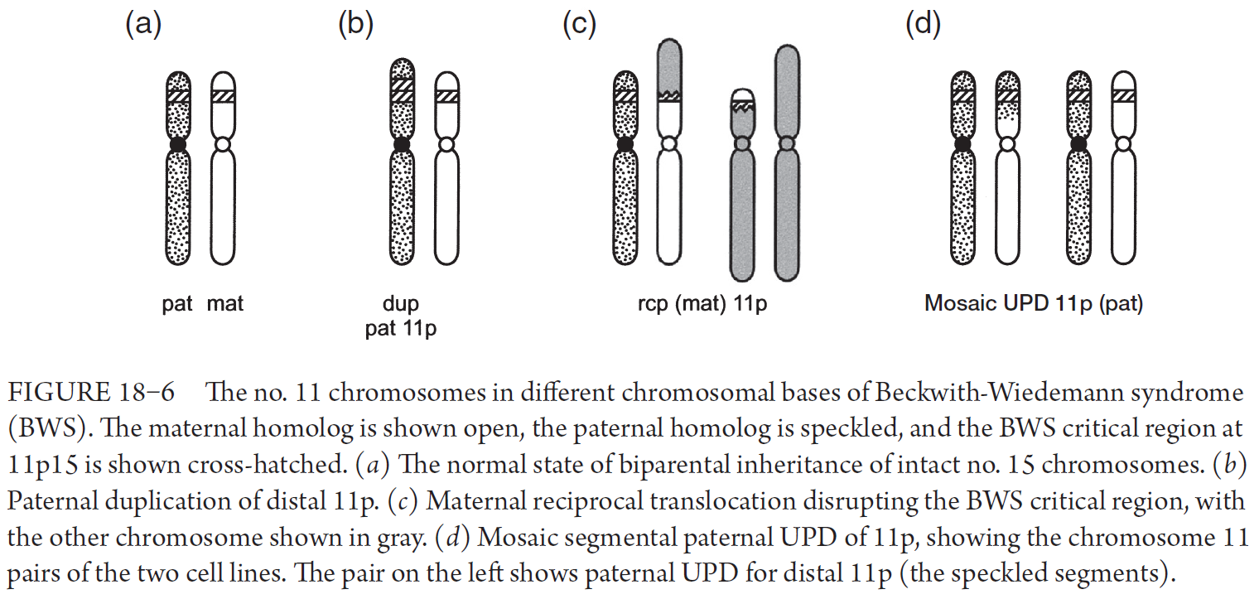

Slide 22
SRS due to 11p anomaly can be considered the countertype to BWS, both clinically and at the molecular level
In SRS due to UPD(11p)mat or to 11p epimutation (hypomethylation of DMR1), the maternally active gene H19 functions biallelically, whereas IGF2 is underexpressed

Slide 23
Chromosome 14
UPD14 produces different syndromes according to the paternal or maternal basis of the disomy
Either may be seen in the setting of a normal karyotype or with a Robertsonian translocation (or “acrocentric isochromosome”)
A balanced 45,der(13;14) Robertsonian translocation may reflect correction of an initially 46,der(13;14),+ 14 conception
45,der(14;14) case might result from a 45,–14 conception which then corrected by reduplication of the single chromosome 14 to give an i(14q) with isodisomy
Pat UPD14 (Kagami-Ogata syndrome) is more severe and survival is poor
Mat UPD14 (Temple syndrome) produces a syndrome of pre- and postnatal growth retardation

Slide 24
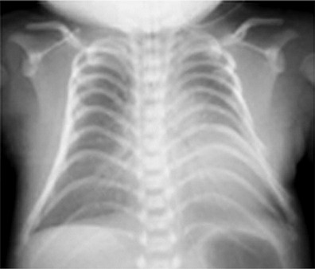
The bell-shaped thorax is a particular clinical pointer in Kagami-Ogata syndrome
FIGURE 14–27 Chest X-ray of a child with Kagami-Ogata syndrome, in this case due to an epimutation in the 14q32.2 imprinted region. The thorax is narrow in its upper and mid parts, and flaring below. The ribs have an increased “coat-hanger” angle.

Slide 25
Chromosome 15
Prader-Willi syndrome (PWS) and Angelman syndrome (AS) are the two UPD15 syndromes
PWS: phenotype due to loss of transcription of several genes and RNA transcripts on the paternal chromosome 15. Among these, deficiency of a particular cluster of small nucleolar RNA genes (snoRNAs) called SNORD 116 is responsible for the key features of PWS.
Different components of the PWS phenotype are mediated via perturbed functioning of different genetic targets of these snoRNAs
AS: absent activity of UBE3A gene on maternal chromosome 15
Both SNORD 116 and UBE3A are under influence of imprinting control center (IC)

Slide 26
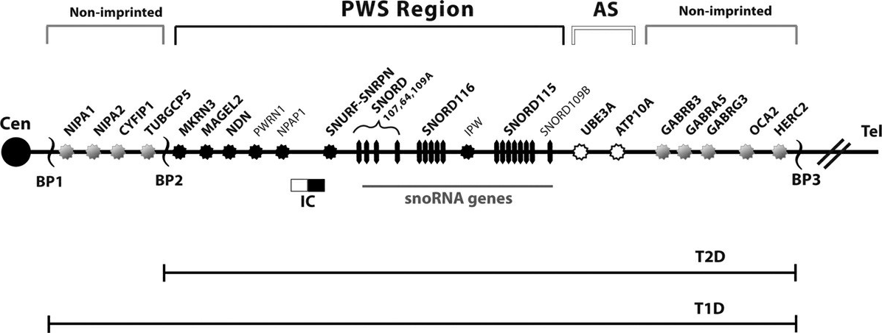
FIGURE 18–7 The regions and loci of interest within the segment 15q11.2q13.3. AS, Angelman syndrome; BP, (numbered) breakpoint; PWS, Prader-Willi syndrome; T1D, T2D, type 1, type 2 deletion. Black, white, and gray shading indicates, respectively, PWS-related, AS-related, and non-imprinted loci. IC, imprinting center: The black IC segment is the PWS-IC, influencing the black-coded loci in the PWS region; the white IC segment is the AS-IC, influencing the white-coded loci in the AS region.

Slide 27
Absence of gene activity is due either to the loss, or to the nonfunctioning, of PWS/AS region on one chromosome 15 homolog
Loss is most commonly due to a simple interstitial deletion.
Whether the phenotype comes to be PWS or AS depends upon which parent contributed the deleted chromosome
Nonfunctioning of (structurally normal) genes within 15q11 is due to the imprint status. This is most commonly the consequence of UPD 15, with the phenotype determined according to the parent of origin of the disomic pair of chromosomes
A rare cause is failure of, or damage to, the chromosome 15 IC
In the case of AS, mutation in the UBE3A gene is a further category of mechanism

Slide 28
The 15q11 Imprinting Center
Normal persons have one paternally imprinted chromosome 15
and one maternally imprinted chromosome 15
The imprinting state of a chromosome 15 is set and reset as it is transmitted down the generations, according to the sex of the transmitting parent
Resetting— an “epigenetic modification”—is dictated during gametogenesis from the cis-acting IC, with methylation of genes
The IC is bipartite, with a centromeric element, the AS-IC, and 35 kb distant a telomeric element, the PWS-IC
In maternal gametogenesis, the AS-IC has responsibility for initiating a
paternal → maternal switch on the chromosome 15 that the mother herself had received from her father

Slide 29
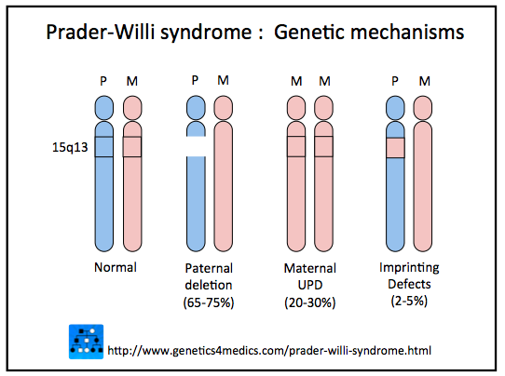
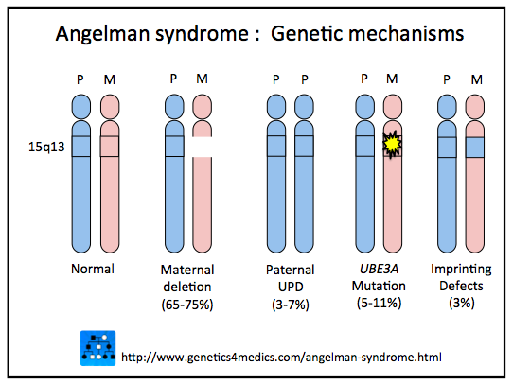

Slide 30
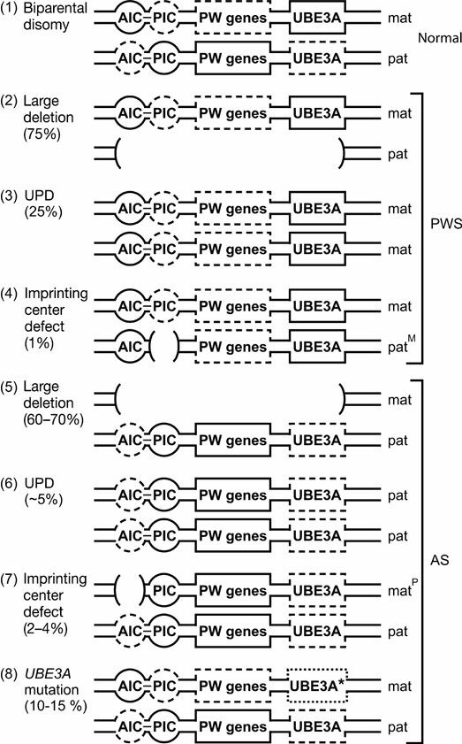
FIGURE 18–8 An outline of the different genetic forms of Prader-Willi syndrome (PWS) and Angelman syndrome (AS).

Slide 31
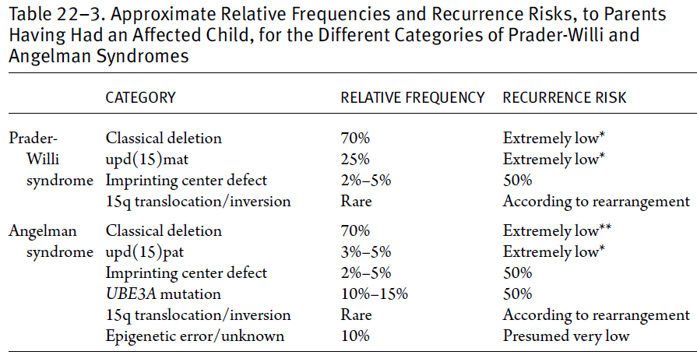

Slide 32
